Slide 1
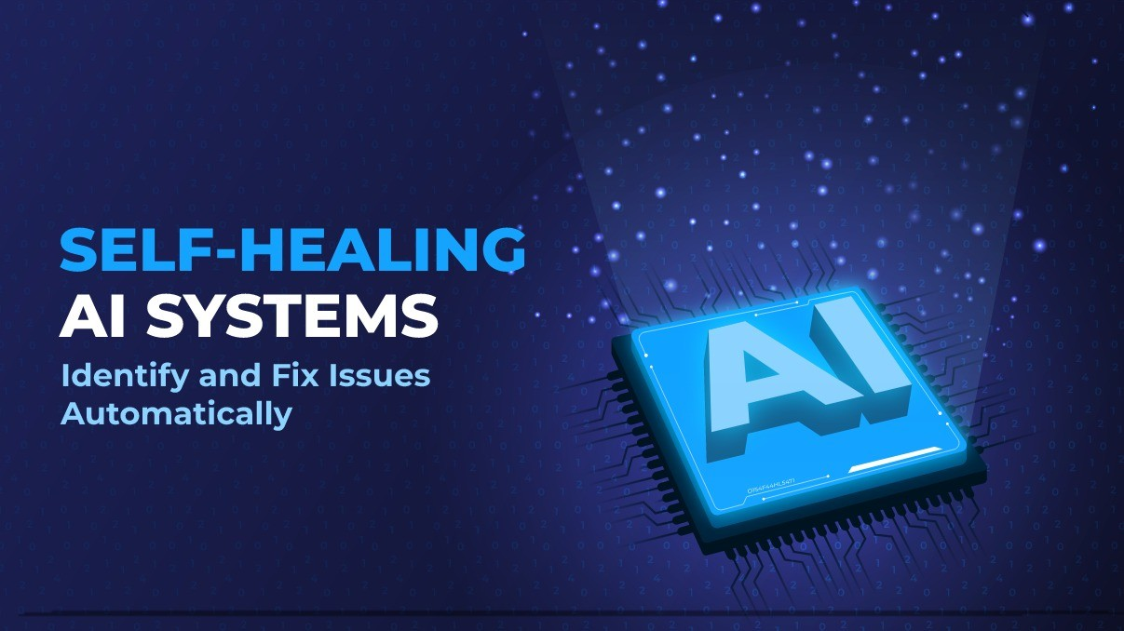
AutoHealAI: Intelligent Multi-Agent Platform
Syed Abjimiah
&
Amit Kumar Yadav

Slide 2
What is Self-Healing?
Self-Healing is an intelligent capability that enables a software system to automatically detect failures, identify the root cause, recover from the issue, and verify that the service is healthy again—without requiring manual intervention.
Instead of waiting for an engineer to investigate production issues, AI agents continuously monitor the application, analyse logs, perform recovery actions, validate the results, and restore normal operations automatically.
Why Self-Healing?
Traditional applications rely heavily on manual monitoring and troubleshooting, which increases downtime and impacts user experience.
AutoHealAI minimizes service disruption by providing:
Automatic Failure Detection
Intelligent Root Cause Analysis
Automated Recovery Actions
Continuous Health Verification
Reduced Mean Time To Recovery (MTTR)
Improved System Reliability and Availability

Slide 3
Project Overview (PRD)
Project Type: Intelligent Multi-Agent Platform for Weather API Monitoring & Automated Recovery.
Domain : Weather API Monitoring
Project Description:
AutoHealAI is an AI-powered multi-agent platform designed to continuously monitor Weather APIs, detect service failures, diagnose the underlying causes, automatically perform recovery actions, verify system health, and restore services with minimal downtime.
The system combines autonomous AI agents, GraphRAG, observability, and automated healing workflows to ensure high availability and reliable weather information for end users.
Scope
• Real-Time Weather API Monitoring
• Intelligent Incident Detection
• AI-Based Root Cause Analysis
• Automatic Service Recovery
• Validation & Health Checks
• Continuous Learning

Slide 4
Problem Statement: 1
Existing System (Without Self-Healing)
Example 1 — Weather API Downtime
Scenario
A user requests:
"What is the weather in Chennai today?“
The Weather API server unexpectedly crashes.
Result:
❌ API returns HTTP 503 Service Unavailable
❌ User receives an error message
❌ Support team receives alerts
❌ Engineers manually inspect logs
❌ container is restarted manually
❌ Users wait several minutes
With AutoHealAI (Self-Healing)
Example 1
User asks:
"What is the weather in Chennai today?"
Workflow:
User Request
Monitoring Agent detects HTTP 503
Diagnosis Agent analyzes logs
Root Cause Agent identifies stopped Docker container
Healing Agent restarts Weather API
Validation Agent confirms API health
Weather information is returned successfully
Result:
✅ User receives weather information
✅ Recovery completed automatically
✅ No manual intervention required

Slide 5
Problem Statement: 2
Without Self-Healing
Example 2 — Slow Weather API Response
A user searches:
"Weather forecast for Bangalore.“
The API experiences high latency because of increased traffic.
Result:
❌ Response takes 40 seconds
❌ Request eventually times out
❌ User refreshes repeatedly
❌ Customer experience is degraded
❌ Engineers investigate after complaints
With AutoHealAI (Self-Healing)
Example 2
User asks:
"Weather forecast for Bangalore“
Workflow:
Monitoring Agent detects slow response
Diagnosis Agent identifies high CPU utilization
Healing Agent scales service or clears overloaded processes
Validation Agent performs health check
API response time returns to normal
Result
✅ Fast response restored
✅ No service interruption

Slide 6
Project Goals
Goal 1
Continuous Monitoring
Monitor Weather APIs 24×7 to detect failures, slow responses, and abnormal behavior in real time.
Goal 2
Intelligent Diagnosis
Analyze application logs, metrics, and health data to determine the actual root cause of incidents.
Goal 3
Automated Recovery
Execute predefined healing actions such as restarting services or recovering failed containers automatically.
Goal 4
Health Verification
Validate that the Weather API is functioning correctly after recovery before serving users.
Goal 5
Continuous Learning
Capture incident history and successful recovery patterns to improve future decision-making.
Goal 6
Operational Excellence
Reduce downtime, minimize manual effort, and improve overall service reliability.

Slide 7
Project Features
Key Features
Interactive Streamlit Chat Interface LangSmith Observability & Monitoring
Weather API Integration Audit Logging & Middleware
Real-Time Health Monitoring Agent Docker-Based Deployment
AI-Based Diagnosis Agent
Root Cause Analysis Agent
Automated Healing Agent
Recovery Validation Agent
Learning Agent for Knowledge Retention
Drift Layer and SQLite DB

Slide 8
Weather API Self-Healing- Architecture Diagram
User Layer
API & Service Layer
Middleware Layer
Graudrails Layer
Agents Layer
Knowledge Layer
Observability Layer
Streamlit UI
Chat Interface
Weather API
Knowledge Layer
(SQLite DB for save incident and request logs)
AI Agent Orchestration Layer
(LangGraph Supervisor)
Fast API
Rest API Endpoints
Monitoring
Agent
LLM
Diagnosis
Agent
Langsmith
Traces
Metrics
Evaluation
Dashboards
Logging
Monitoring
Audit Trail
Error Handling
Healing
Agent
Middleware
Validation
Agent
Learning
Agent
Drift Layer
(Detect API/ Schema and data behaviour)
Notification
Agent(Email)
Deployment Layer
Docker
Azure Container
Git Action
API Schema Drift
Data Anamoly Drift
Multi-cloud deployment
Support for multiple Weather APIs

Slide 9
Agents WorkFlow - Diagram
Failure
(Down/Slow/Error)
1.Monitoring
(Detect Failures)
2. Diagnosis
(Analyse logs, metrics &alerts)
3. Healing
(Perform recovery actions – Restart, scale, fix)
4. Validation
(Health Check)
Weather API
Request
From User
Weather API
Recovery Success?
Return output to User
Email Will Trigger to Support team.
Retry
(Max Retry Count)
No
Yes
All Retries Failed

Slide 10
End-to-End Workflow
User
│
▼
Streamlit Chat Interface
│
▼
User enters weather query
"Weather in Chennai"
│
▼
FastAPI Receives Request
│
▼
Middleware Processing
• Logging
• Monitoring
• Audit Trail
• Error Handling
│
▼
Drift Layer
• ApI schema
• Anamoly detection
│
▼
Request sent to Weather API
Weather API Failure
(503 / Timeout / Slow API)
│
▼
Monitoring Agent Detects Issue
│
▼
Diagnosis Agent Analyses Logs
│
▼
Healing Agent Executes Recovery • Restart Weather API • Retry Request • Clear Cache • Restart Container
Validation Agent Performs Health Check │ ▼ Recovery Successful? ┌───────┴────────┐ │ │ YES NO │ │ ▼ ▼ Learning Agent Retry Recovery Stores Incident (Max Retry) Knowledge │ │ │ └──────────┬──────┘ ▼ Recovery Successful? │ ┌────┴────┐ │ YES NO │ │ ▼ ▼ Return Weather Send Alert to Response User Support Team

Slide 11
Failure Scenarios
Failures
Network Error
Weather API Down
HTTP Rate Limit 429
API Timeout
Invalid JSON
LLM Timeout
Invalid API Key
Database Down
Schema Drift
Data Anomaly Drift

Slide 12
Business Benefits
80–90% reduction in manual intervention
Lower Mean Time to Recovery (MTTR)
Higher API availability
Improved customer experience
Faster incident resolution
Reduced operational costs
24×7 automated monitoring
Scalable and production-ready architecture
Future Enhancements
Examples:
Kubernetes auto-scaling
Predictive failure detection
Grafana dashboard integration
Voice-enabled AI assistant

Slide 13
Conclusion
AutoHealAI demonstrates how autonomous AI agents can transform traditional API monitoring into an intelligent self-healing platform.
By combining continuous monitoring, AI-driven diagnosis, automated recovery, and health validation, the platform significantly reduces downtime and operational effort while improving service reliability.
The modular architecture based on LangGraph, GraphRAG, LangSmith, and Docker enables scalable deployment and can be extended to monitor domains beyond Weather APIs, making it suitable for enterprise production environments.

